Slide 1
Level 3
Student’s name:

Slide 2
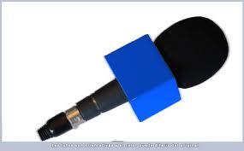
Send an e-mail to your teacher including next topic. Use different verb tenses and send your pronunciation:
An invitation for your graduation ceremony
From:
To:
Subject:
Message

Slide 3
Describe all topics you learned during your study time at Ciberschool and experiences you’ll always remember:
At Ciberschool I learned….
1. I learned how to use the present perfect tense
2. I know how to make suggestions.
3. I won’t forget the moment in which I met some very special friends by internet
4.
5.
6.
7.
8.
9.
10.
11.
12.

